Slide 1

Salaat Tutor
Notes:
V1: 18th Dhul Hijjah, 1438, September, 2017
V2: 13th Rajab, 1440, March 19, 2019
V3: 21st Muharram, 1442, September 18, 2020

Slide 2
Dedicated to:
All parents/guardians who are helping their children to learn how to pray
All students who are trying to learn how to pray
Please recite Surah al-Fatiha and 3x Surah al-Ikhlas for the marhumeen of all volunteers at madressahs and Islamic centres.

Slide 3
Objectives
  Learn the positions of salah
  Practice and memorize parts of salah
  Learn the beautiful meaning of the recitation
  Learn what are the wajib parts of salah

Slide 4
How to Play and Learn
Look at the picture and read how to do the position
Click on and repeat Arabic recitation after Salah Tutor 3 times
Click on & repeat 3 times
Click on & repeat 3 times
When you can recite word for word, skip step 2 and go directly to phrase or full icons
Learn the beautiful meaning of the recitations
Word
Phrase
Full

Slide 5
Dhikr Schedule
Week 1
  Ruku
Week 2
  After Ruku
Week 3
  Sajdah
Week 4
  Juloos between 2 Sujud
Week 5
  Standing up after 2nd Sajdah
Week 6
  Tashahhud
Week 7
  Tasbihat al-Arba’a
Week 8
  Salaam

Slide 6
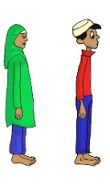



Niyyah
Stand straight facing qibla.
Boys: legs slightly apart.
Girls: legs together.
Hands to the side. Look down at the turbah. And say:
I am praying Salat al-_______ <fajr two> <dhuhr four> <‘asr four> <maghrib three> <‘isha four> rak’ahs
قُرْبَةً اِلَى اللَّهِ تَعَالَى
For seeking closeness to Allāh
(don’t say illallah – which is incorrect)
Word
Phrase
Full

Slide 7
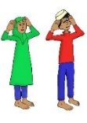
Takbiratul Ehram
Raise both hands towards your ears with palms facing out towards qibla and say loudly:
اللَّهُ أكْبَر
Allāh is the Greatest!
Word
Phrase
Full

Slide 8
Qira’ah
Surah al-Fatiha
بِسْمِ اللَّهِ الرَّحْمٰنِ الرَّحِيمِ.
الْحَمْدُ لِلَّهِ رَبِّ الْعَالَمِينَ
الرَّحْمَانِ الرَّحِيمِ
مَالِكِ يَوْمِ الدِّينِ
إِيَّاكَ نَعْبُدُ وَإِيَّاكَ نَسْتَعِينُ
اهْدِنَا الصِّرَاطَ الْمُسْتَقِيمَ
صِرَاطَ الَّذِينَ أَنْعَمْتَ عَلَيْهِمْ غَيْرِ الْمَغْضُوبِ عَلَيْهِمْ وَلاَ الضَّالِّينَ
And any other full surah e.g. Surah al-ikhlas
بِسْمِ اللَّهِ الرَّحْمٰنِ الرَّحِيمِ
قُلْ هُوَ اللَّهُ أَحَدٌ ، اللَّهُ الصَّمَدُ ، لَمْ يَلِدْ وَلَمْ يُولَدْ وَلَمْ يَكُنْ لَهُ كُفُوًا أَحَدٌ
اللَّهُ أكْبَر
Al-Fatiha
Word
Phrase
Full
Word
Phrase
Full
Al-Ikhlas

Slide 9
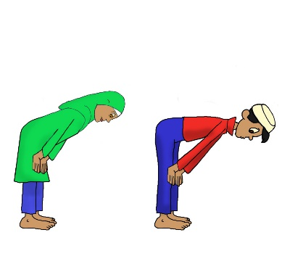
Ruku
Dhikr Schedule
Look straight down at toes.
Boys: back straight. Legs a little apart. Elbows a little out.
Girls: hands straight. Legs together. Recite:
سُبْحَانَ رَبِّي العَظِيمِ وَبِحَمْدِه
Free from all defects is my Lord, and with His praise I bow. O Allāh! Send Your Blessings on Muhammad and his family.
Word
Phrase
Full

Slide 10

Standing up (Qiyam) after Ruku’
Dhikr Schedule
Stand still for 1-2 seconds
Then recite while standing still:
سَمِعَ اللَّهُ لِمَنْ حَمِدَه
Allāh listens to one who praises Him.
Word
Phrase
Full

Slide 11
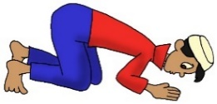
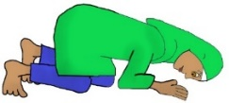
Sajdah
Dhikr Schedule
Forehead, both palms, both knees and both toe thumbs on ground.
Boys: keep elbows off the ground. Girls: elbows to touch ground as well.
Recite:
سُبْحَانَ رَبِّي الأعْلَى وَبِحَمْدِه
اللَّهُ أكْبَر
Glory be to my Great Sustainer, Most High, and I praise Him. O Allāh send Your Blessings on Muhammad and his family.
Word
Phrase
Full

Slide 12
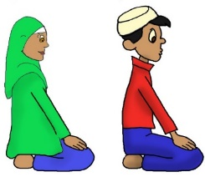
Juloos
Between the two Sujud
Dhikr Schedule
Sit up straight first. Palms on thighs with fingers together.
Then when sitting still, raise palms to ears and say takbir
اللَّهُ أكْبَر
Then recite:
أسْتَغْفِرُ اللَّهَ رَبِّي وَ أتُوبُ إلَيه
I ask Allāh, my Lord, to cover up my sins and unto Him I turn repentant, Allāh is Greatest.
Word
Phrase
Full

Slide 13
Sajdah
Dhikr Schedule
Forehead, both palms, both knees and both toe thumbs on ground.
Boys: keep elbows off the ground. Girls: elbows to touch ground as well.
Recite:
سُبْحَانَ رَبِّي الأعْلَى وَبِحَمْدِه
اللَّهُ أكْبَر
Glory be to my Great Sustainer, Most High, and I praise Him. O Allāh send Your Blessings on Muhammad and his family.
Word
Phrase
Full

Slide 14
Standing up for next rak’ah
Dhikr Schedule
As you stand, recite:
بِحَولِ اللهِ وَ قُوَتِهِ أقُومُ وَأقْعُد
اللَّهُ أكْبَر
With the power of Allāh and the strength from Him I rise and sit.
Boys: when standing up, first place both palms flat on the ground in front of you. Raise knees from ground first and palms last.
Girls: stand up without placing palms in front.
Word
Phrase
Full

Slide 15
Qira’ah
Surah al-Fatiha
بِسْمِ اللَّهِ الرَّحْمٰنِ الرَّحِيمِ.
الْحَمْدُ لِلَّهِ رَبِّ الْعَالَمِينَ
الرَّحْمَانِ الرَّحِيمِ
مَالِكِ يَوْمِ الدِّينِ
إِيَّاكَ نَعْبُدُ وَإِيَّاكَ نَسْتَعِينُ
اهْدِنَا الصِّرَاطَ الْمُسْتَقِيمَ
صِرَاطَ الَّذِينَ أَنْعَمْتَ عَلَيْهِمْ غَيْرِ الْمَغْضُوبِ عَلَيْهِمْ وَلاَ الضَّالِّينَ
And any other full surah e.g. Surah al-ikhlas
بِسْمِ اللَّهِ الرَّحْمٰنِ الرَّحِيمِ
قُلْ هُوَ اللَّهُ أَحَدٌ ، اللَّهُ الصَّمَدُ ، لَمْ يَلِدْ وَلَمْ يُولَدْ وَلَمْ يَكُنْ لَهُ كُفُوًا أَحَدٌ
اللَّهُ أكْبَر
Al-Fatiha
Word
Phrase
Full
Word
Phrase
Full
Al-Ikhlas

Slide 16

Qunut
Dhikr Schedule
Recite:
رَبَّنَا آتِنَا فِي الدُّنْيَا حَسَنَةً وَفِي الآخِرَةِ حَسَنَةً وَقِنَا عَذَابَ النَّارِ
My Lord, give me good in the world and good in the hereafter and save me from the punishment of the fire. O Allāh! Send Your Blessings on Muhammad and his family.
Word
Phrase
Full

Slide 17
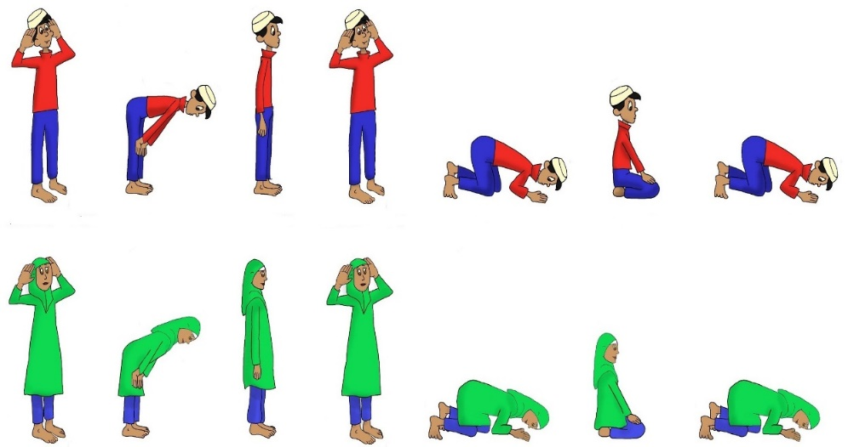
Takbir & ruku until 2nd sajdah (like in 1st rak’ah)

Slide 18

Tashahhud
Dhikr Schedule
Recite:
أشْهَدُ أن لا إلَهَ إلا الله وَحْدَهُ لا شَرِيكَ لَه وَأشْهَدُ أنَّ مُحَمَداً عَبْدُهُ وَرَسُولُه, اللَّهُم صَلِّ عَلَى مُحَمَدٍ وَآلِ مُحَمَد
I testify that there is none worth worshipping except the Almighty Allāh, Who is One and has no partner, and I testify that Muhammad is His servant and messenger. O Allāh! Send Your blessings on Muhammad and his progeny.
Word
Phrase
Full

Slide 19
Standing up for next rak’ah
Dhikr Schedule
As you stand, recite:
بِحَولِ اللهِ وَ قُوَتِهِ أقُومُ وَأقْعُد
اللَّهُ أكْبَر
With the power of Allāh and the strength from Him I rise and sit.
Boys: when standing up, first place both palms flat on the ground in front of you. Raise knees from ground first and palms last.
Girls: stand up without placing palms in front.
Word
Phrase
Full

Slide 20
Tasbihat al- ‘Arba’a (Qirā’ah of 3rd and 4th Rak’ah)
Dhikr Schedule
Recite tasbihat al-‘arba’a three times
سُبْحَانَ الله,
وَالحَمْدُ لله،
وَلا إلَهَ إلا الله،
وَالله أكْبَر
Glory be to Allāh,
and all praise is for Allāh
and there is no one worth worshipping besides Allāh,
and Allāh is Greater than any description.
Word
Phrase
Full

Slide 21

Takbir & ruku until 2nd sajdah (like in 1st rak’ah)

Slide 22
Tashahhud
Recite:
أشْهَدُ أن لا إلَهَ إلا الله وَحْدَهُ لا شَرِيكَ لَه وَأشْهَدُ أنَّ مُحَمَداً عَبْدُهُ وَرَسُولُه, اللَّهُم صَلِّ عَلَى مُحَمَدٍ وَآلِ مُحَمَد
I testify that there is none worth worshipping except the Almighty Allāh, Who is One and has no partner, and I testify that Muhammad is His servant and messenger. O Allāh! Send Your blessings on Muhammad and his progeny.
Word
Phrase
Full

Slide 23
Salām
Dhikr Schedule
Recite:
السَّلامُ عَلَيكَ أيُّهَا النَبِي وَرَحْمَة الله وَبَرَكَاتُه،
السَّلام عَليْنَا وَعَلَى عِبَاد الله الصَالِحِين،
السَّلامُ عَليْكُمْ وَرَحْمَة الله وَبَرَكَاتُه
(Mustahab: 3 Allāhu Akbar)
Allāh's peace, mercy and blessings be upon you, O Prophet!
Allāh's peace be on us and upon all pious servants of Allāh.
Allāh's peace, mercy and blessings be on you all!
Word
Phrase
Full

Slide 24
Salah – Wajib parts
Niyyah (intention)
Takbirat al-Ihram
Qiyam
Ruku
Sujud
Qira’ah
Dhikr of ruku & sujud
Tashahhud
Salam
Tartib
Muwalat

Slide 25
Masha Allah!
Congratulations for making the effort to learn how to pray salah.
Please remember to make dua for all those who are sick or in need.
May Allah (swt) accept your prayers and may He reward you for your efforts. Illahi Ameen.

